Slide 1

Job Portal Website: Connecting Talent with Opportunities
Our comprehensive job portal streamlines the hiring process, empowering job seekers to easily find and apply for their dream roles, while enabling employers to seamlessly connect with qualified candidates.

Slide 2
Tech Stack
Front-End
Back-End
Database
React.js - A powerful JavaScript library for building user interfaces.
Node.js and Express - A robust runtime environment and web application framework for server-side development.
MongoDB - A flexible and scalable NoSQL database for storing job postings and user data.

Slide 3

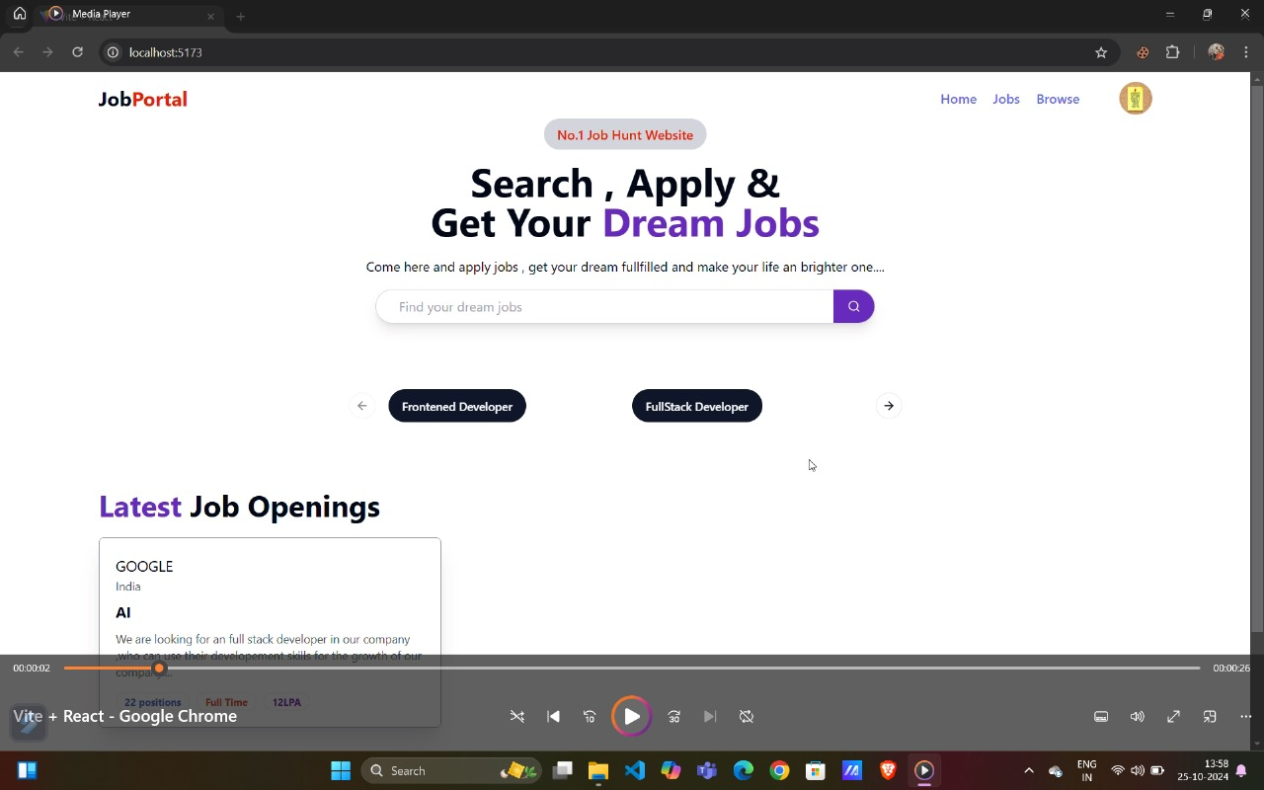
Job Portal Description
Our job portal streamlines the hiring process, empowering job seekers to easily find and apply for their dream roles, while enabling employers to connect with qualified candidates seamlessly. With a user-friendly interface and powerful features, our platform aims to bridge the gap between talent and opportunity, helping both job seekers and employers achieve their goals.

Slide 4

Key Features
1
Job Search
2
Recruiter Profiles
Comprehensive search functionality to help job seekers find relevant opportunities.
Intuitive tool for job seekers to create and manage their professional resumes.
3
Employer Profiles
4
Application Tracking
Detailed company information to help job seekers learn about potential employers.
Streamlined process for job seekers to monitor the status of their applications.

Slide 5
Project Showcase
Home Page
Job Listing
Candidate Dashboard
Visually appealing and intuitive landing page to introduce the job portal's features.
Comprehensive view of available job opportunities with detailed descriptions.
Personalized interface for job seekers to manage their applications and profile.

Slide 6

User Experience
Intuitive Navigation
Mobile-Responsive
The website's intuitive layout and clear signposting make it easy for users to find what they need.
The job portal is designed to provide an optimal experience across all devices, including smartphones and tablets.
Personalized Recommendations
The platform leverages user data to provide personalized job recommendations, enhancing the user experience.

Slide 7



Data Security
Encrypted Data
Two-Factor Authentication
All user data is securely stored and transmitted using advanced encryption techniques.
An additional layer of security to protect user accounts from unauthorized access.

